Slide 1

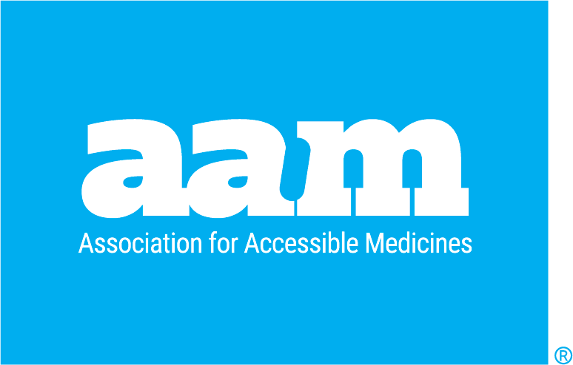
The U.S. Generic
& Biosimilar Medicines Savings Report
SEPTEMBER 2025

Slide 2
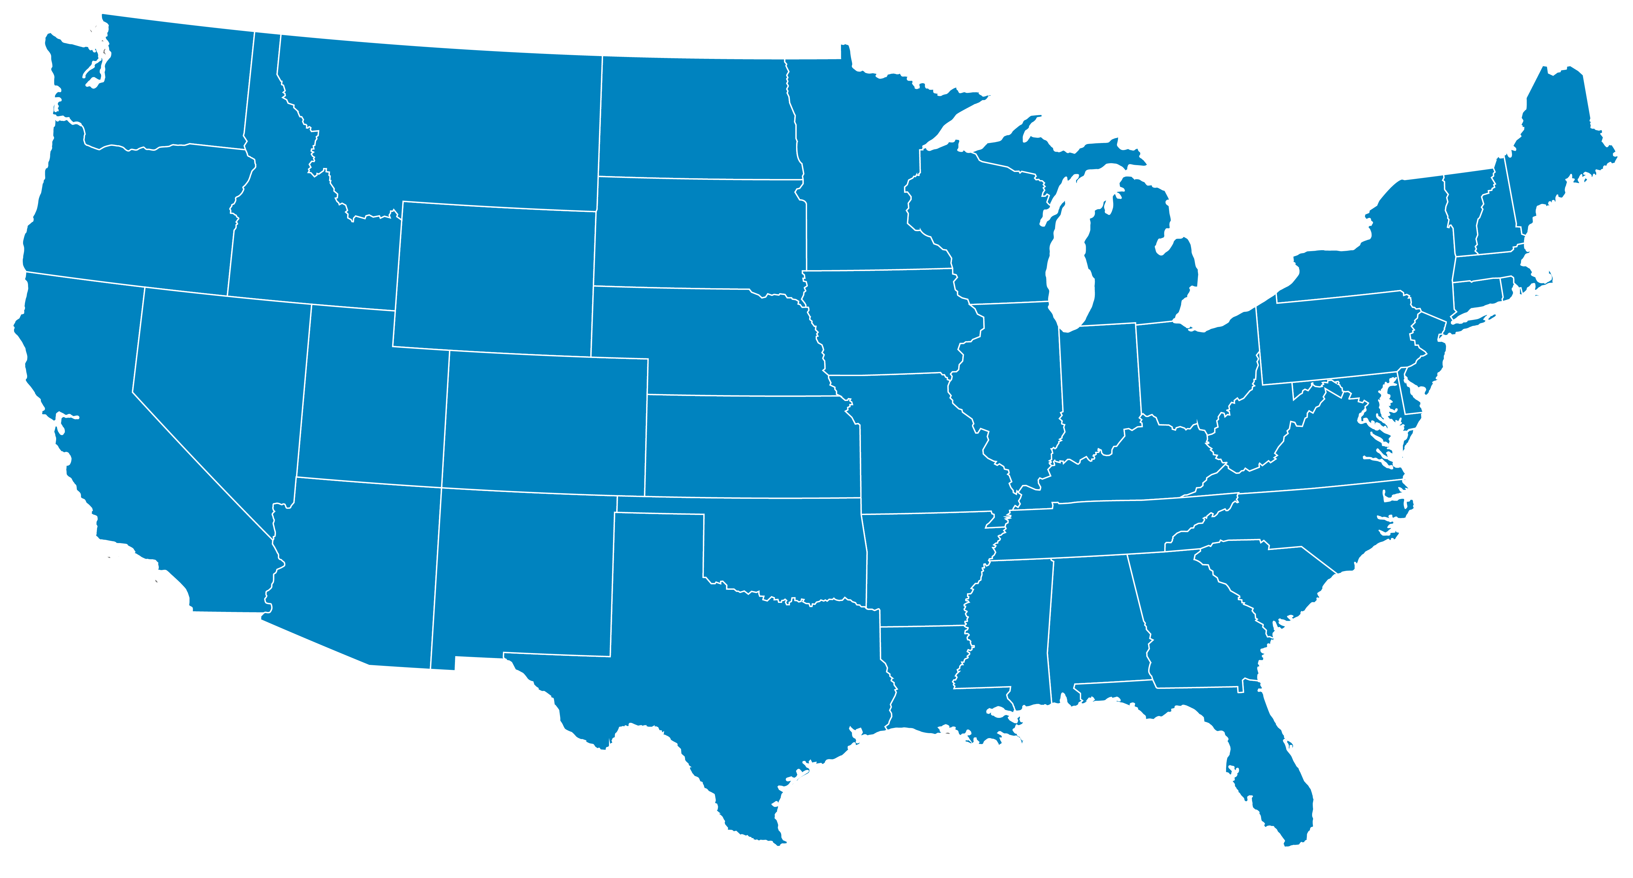
Member Companies U.S. Footprint
As of August 2025
Chicago, IL
Lake Zurich, IL
Melrose Park, IL
Bedford, OH
Middleburgh, NY
Salt Lake City, UT
Brookhaven, NY
Chestnut Ridge, NY
Hauppauge, NY
Melville, NY
Pearl River, NY
Shirley, NY
Basking Ridge, NJ
Berkeley Heights, NJ
Branchburg, NJ
Bridgewater, NJ
Cherry Hill, NJ
Cranbury, NJ
Dayton, NJ
East Brunswick, NJ
East Hanover, NJ
East Windsor, NJ
Edison, NJ
Elizabeth, NJ
Fairfield, NJ
Iselin, NJ
Mahwah, NJ
Monmouth Junction, NJ
Parsippany, NJ
Pennington, NJ
Piscataway, NJ
Princeton, NJ
Somerset, NJ
Warren, NJ
Hazelwood, MO
Minneapolis, MN
Cincinnati, OH
Allegan, MI
Grand Island, NY
Wilmington, MA
Billerica, MA
Boston, MA
Canton, MA
Fall River, MA
Columbus, OH
New Albany, OH
Allentown, PA
Bethlehem, PA
Blue Bell, PA
New Britain, PA
North Wales, PA
Yardley, PA
West Chester, PA
Baltimore, MD
Salisbury, MD
Forest, VA
Durham, NC
Raleigh, NC
Wilson, NC
South El Monte, CA
Brea, CA
Carlsbad, CA
Chino, CA
Irvine, CA
Solana Beach, CA
Rancho Cucamonga, CA
Monroe, NC
Greenville, SC
Piedmont, SC
Glasgow, KY
Olive Branch, MS
Daytona Beach, FL
Coral Springs, FL
Davie, FL
Miramar, FL
Sunrise, FL
Weston, FL
Naples, FL
Carrollton, TX

Slide 3
Key Takeaways and Year Over Year Trends
THE U.S. GENERIC & BIOSIMILAR MEDICINES SAVINGS REPORT

Slide 4

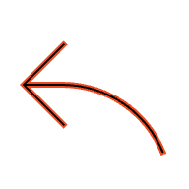
Key Advocacy Takeaways
Brand Drugs Drive Costs. Generics Drive Savings.
Generic Medicines
Brand Drugs
90%
10%
Total Savings from Generics and Biosimilars
Total generic and biosimilar savings in 2024: $467 billion Total generic and biosimilar savings for the past ten years: $3.4 trillion Generic share of total U.S. prescriptions filled: 90 percent Generic share of total U.S. prescription drug spending: 12 percent Generic share of total U.S. healthcare spending: 1.2 percent Total generic savings in Medicare in 2024: $142 billion ($2,643 per beneficiary) Total generic savings in Medicaid in 2024: $62.1 billion ($782 per enrollee)
Rx Drugs Filled
3.9B
Generic Rx
Rx Drugs Filled
435M
BRAND Rx
12%
88%
Rx Drug Spending
$700B
Rx Drug Spending
$98B
Biosimilar Savings
Savings in 2024: $20.2 billion Total savings since first biosimilar entry in 2015: $56.2 billion Total days of patient therapy since 2015: 3.3 billion Incremental days of patient therapy that would not have occurred without biosimilar competition: 460 million​
Source: IQVIA National Prescription Audit, December 2024.

Slide 5
In 2024, 90% of Prescriptions Were Dispensed as Generics
Over 3.9 Billion Generic Prescriptions Were Dispensed in 2024
Source: IQVIA National Prescription Audit, December 2024; IQVIA Institute, June 2025.

Slide 6
Biosimilars Market Overview
84
90% of the 118 biologics losing exclusivity in the next decade—valued at $234 billion overall—currently have no biosimilars in development.
APPROVED
67
Biosimilar savings since 2015
$56.2 BILLION
MARKETED
21
Biosimilars have been used in almost
3.3 BILLION DAYS of patient therapy and have resulted in more than 460 MILLION INCREMENTAL DAYS of therapy
REFERENCE PRODUCTS
As of July 11, 2025
Source: US FDA and AAM Commercial Assessment. Includes 9 unbranded products.
Savings and patient day data developed by the Biosimilars Council with IQVIA.

Slide 7
Generics Are 90%of All Prescriptions, But Only 12% of Spending
Generic Share of Spending Continues to Fall
Source: IQVIA National Prescription Audit & National Sales Perspective, December 2024; IQVIA Institute, June 2025.

Slide 8
Generics Were 1.2% of Total U.S. Health Care Spending in 2024
1.2%
4.4%
3.1%
8.4%
1.2%
9.9%
59.4%
Source: Keehan et al. National Health Expenditure Projections, 2024–33: Despite Insurance Coverage Declines, Health To Grow As Share Of GDP. Health Affairs 2025. Located at https://www.healthaffairs.org/doi/full/10.1377/hlthaff.2025.00545s

Slide 9
Price Deflation Is More Rapid and Prices Bottom Out Lower for More Recent Patent Expiries Compared to Nearly 30 Years Ago
Average Generic Price % of Brand Pre-Expiry Price by Generic Entry Year
Source: IQVIA National Sales Perspective, December 2024; IQVIA Institute, June 2025.

Slide 10
More Generics Dispensed Means More Savings for Patients
Source: IQVIA National Prescription Audit, December 2024; IQVIA Institute, June 2025.

Slide 11
Patients and Healthcare Professionals Depend on Generics More Each Year
Source: IQVIA National Prescription Audit, December 2024; IQVIA Institute, June 2025.

Slide 12
In 2018, It Took Eight Brand Drugs to Equal the Total Generic Business; in 2023 It Only Takes Two
2018
2021
2023
The Top 8 Brand
Molecules =
$59.5B in Sales
Entire Generic Market =
1,048 Molecules
and
$56.3B in Sales
The Top 4 Brand
Molecules =
$64.6B in Sales
Entire Generic Market =
1,085 Molecules
and
$55.4B in Sales
The Top 2 Brand
Molecules =
$59.2B in Sales
Entire Generic Market =
1,106 Molecules
and
$56.2B in Sales
$4.9B
Stelara
$10.4B
Stelara
$25.3B
Ozempic
$5.1B
Xarelto
$11.9B
Trulicity
$33.9B
Humira
$5.3B
Remicade
$15.6B
Eliquis
$5.5B
Lyrica
$26.8B
Humira
$5.7B
Januvia
$6.8B
Eliquis
$8B
Enbrel
$18.3B
Humira
= 50 Generic Molecules
Data based on the Moving Annual Total month of November
Source: IQVIA US Generics & Biosimilars Trends, Issues & Outlook for AAM, February 2025.

Slide 13
Deflation Puts Generic Market in Peril
Generic prices are launching lower
Generic prices are bottoming out lower
Source: IQVIA National Prescription Audit, December 2024; IQVIA Institute, June 2025.

Slide 14
Rx Shortages Seizing Headlines
Key therapies
25% of drug shortages are within two fields – oncology and neurology – where patients require consistent and timely access to necessary medications
84%
102
Generics
Shortages disproportionately affect generic drugs
Molecules with active shortages or planned discontinuations
Down from 168 in 2011
13
Cancer shortages
69%
56%
Products in shortage are typically low-price, with 56% of molecules in shortage priced at $1 per unit or less
13 oncology molecules are in shortage, with the vast majority (N=12) being sterile injectables
Injectable
Sterile injectables are the majority of shortages
Source: IQVIA Institute for Human Data Science. July 2025. Trends in Drug Shortages and ANDA Approvals in the U.S. Available at iqviainstitute.org.

Slide 15
Savings By Category
THE U.S. GENERIC & BIOSIMILAR MEDICINES SAVINGS REPORT

Slide 16
The Top 10 Products by Volume Represent 19% of the Overall Savings in the Past 10 Years
Generic Savings for the Top 10 Products by Volume 2015–2024 Is $635B
Top 10 products by volume in past 10 years
Product | Generic entry year | Brand pre-expiry price (per unit) | Price of generic equivalent 2024 (per unit) | 10-year savings ($Bn) | Percent savings | 10-year volume units dispensed (Bn)
Glucophage | 2001 | 0.66 | 0.03 | 46.8 | 85% | 83.0
Neurontin | 2003 | 1.02 | 0.05 | 69.7 | 93% | 73.4
Lipitor | 2010 | 3.29 | 0.06 | 190.3 | 97% | 59.6
Toprol Xl | 1993 | 0.41 | 0.06 | 18.5 | 81% | 56.7
Zestril | 1998 | 0.67 | 0.03 | 30.5 | 96% | 47.5
Norvasc | 2006 | 1.54 | 0.02 | 69.6 | 99% | 45.8
Vicodin | 1993 | 0.27 | 0.13 | 6.3 | 55% | 42.3
Prilosec | 2001 | 3.31 | 0.06 | 117.2 | 98% | 36.2
Cozaar | 2009 | 1.51 | 0.06 | 46.7 | 96% | 32.3
Coreg | 2006 | 1.48 | 0.05 | 39.9 | 97% | 27.9
Source: IQVIA National Prescription Audit, December 2024; IQVIA Institute, June 2025.

Slide 17
Generics and Biosimilars Save Billions for Patients
Generic and Biosimilar Medicines Provide Significant Relief for Patients with Chronic and Acute Conditions Alike
Savings by Condition
Product | Total Savings (Primary Condition + Comorbidities)
Heart Disease | $122.2 billion
Mental Illness | $76.8 billion
Diabetes | $61.6 billion
Cancers | $26.6 billion
Allergies & Asthma | $13.9 billion
Arthritis | $6.1 billion
Multiple Sclerosis | $4 billion
Crohn's & Colitis | $2.6 billion
Bone Disease | $2.4 billion
Autoimmune Diseases | $316 billion
Source: IQVIA National Prescription Audit, December 2024; IQVIA Institute, June 2025.

Slide 18
Generics Generated an Average of $8.2B in Savings per State
State Level Savings Estimated Based on Retail Prescriptions
Source: IQVIA National Sales Perspective, PayerTrak.

Slide 19
A Majority of Prescriptions, and Thus Generic and Biosimilar Savings, Are Attributed to Commercially-Insured Patients
State Level Savings Estimated Based on Retail Prescriptions
Source: IQVIA National Sales Perspective, PayerTrak.

Slide 20
Generic Savings At Risk
THE U.S. GENERIC & BIOSIMILAR MEDICINES SAVINGS REPORT

Slide 21
Generic Uptake Is Lower for Generics Entering in the Last 5 Years Compared to Those Entering 10–20 Years Ago
Average Generic Uptake for Small Molecule Generics by Generic Entry Year
Source: IQVIA Insitute for Human Data Science. April 2025. Understanding the Use of Medicines in the U.S. 2025: Evolving Standards of Care, Patient Access, and Spending. Available from iqviainstitute.org.

Slide 22
Summary: Across All First Generics Launched in 2024, an Average of 24% of Medicare and 78% of Commercial Plans Provide Coverage in FY 2025
Percent of First Generics Covered by Medicare Part D and Commercial Plans by Formulary Year
Launch year | 2016 |  | 2017 |  | 2018 |  | 2019 |  | 2020 |  | 2021 |  | 2022 |  | 2023 |  | 2024 |  | 2025
 | M | C | M | C | M | C | M | C | M | C | M | C | M | C | M | C* | M | C* | M | C*
2016 | 22% | 46% | 31% | 68% | 63% | 72% | 58% | 72% | 60% | 76% | 62% | 78% | 61% | 90% | 55% | 87% | 56% | 88% | 54% | 86%
2017 |  |  | 12% | 58% | 25% | 73% | 58% | 73% | 65% | 76% | 65% | 76% | 64% | 89% | 61% | 95% | 65% | 95% | 62% | 93%
2018 |  |  |  |  | 17% | 39% | 27% | 49% | 51% | 59% | 54% | 60% | 54% | 84% | 53% | 91% | 54% | 89% | 54% | 86%
2019 |  |  |  |  |  |  | 31% | 44% | 59% | 60% | 72% | 61% | 72% | 88% | 70% | 90% | 71% | 90% | 70% | 88%
2020 |  |  |  |  |  |  |  |  | 21% | 55% | 41% | 66% | 60% | 90% | 58% | 91% | 58% | 87% | 59% | 85%
2021 |  |  |  |  |  |  |  |  |  |  | 23% | 86% | 46% | 89% | 45% | 84% | 44% | 81% | 42% | 81%
2022 |  |  |  |  |  |  |  |  |  |  |  |  | 39% | 76% | 44% | 76% | 45% | 81% | 58% | 80%
2023 |  |  |  |  |  |  |  |  |  |  |  |  |  |  | 39% | 72% | 45% | 88% | 34% | 86%
2024 |  |  |  |  |  |  |  |  |  |  |  |  |  |  |  |  | 23% | 84% | 24% | 78%
*New analysis
*Note: New commercial analyses were conducted using Clarivate data; previous analyses were conducted using MMIT data
Source: Association for Accessible Medicines. June 2025. Breaking Barriers: Harnessing the Potential of Generics in Medicare and Commercial Market Drug Spending. https://accessiblemeds.org/wp-content/uploads/2025/06/harnessing-the-potential-of-generics.pdf

Slide 23
Medicaid Inflationary Rebates
AMP May Change Due to a Change in Manufacturer-Purchaser Contracting
Quarter 1
Quarter 2
Product X
WAC: $1.00 per bottle
($.01 per unit)
(1 unit = 1 pill)
Product X
WAC: $1.00 per bottle
($.01 per unit)
(1 unit = 1 pill)
In Quarter 2, Purchaser C buys an interchangeable product from Manufacturer Y at the same $.008 per pill
500 bottles at $1.00 per bottle ($.01 per pill)
1000 bottles at $.90 per bottle ($.009 per pill)
2000 bottles at $.80 per bottle ($.008 per pill)
500 bottles at $1.00 per bottle ($.01 per pill)
1000 bottles at $.90 per bottle ($.009 per pill)
Purchaser A
Purchaser B
Purchaser C
Purchaser A
Purchaser B
Purchaser C
In quarter 1, Purchasers A, B and C bought Product X at varying prices per unit. Quarter 1 AMP: $.857 per 100 units
In quarter 2, Purchaser C ended its contract with the manufacturer. Quarter 2 AMP: $.933 per 100 units
Source: Avalere Health. February 2025. White Paper: The Medicaid Drug Rebate Program and Considerations for Generic Markets. https://advisory.avalerehealth.com/insights/white-paper-the-medicaid-drug-rebate-program-and-considerations-for-generic-markets
Change in AMP: +8.9%

Slide 24
Inflation Reduction Act
THE U.S. GENERIC & BIOSIMILAR MEDICINES SAVINGS REPORT

Slide 25
IRA Timeline Harms Generic and Biosimilar Competition
1
4 years = The earliest date a paragraph IV certification can occur for New Chemical Entities
5 years = When the 30 month stay begins if a paragraph IV certification has occurred
7 years = IRA date for which a brand drug is eligible for drug price negotiation
7.5 years = Earliest date that a generic drug can receive FDA approval*
12.5 – 14.5 years = Average time before a generic drug can launch (i.e., when all patents are resolved)
Generics chart adapted from Kesselheim et al: https://www.ncbi.nlm.nih.gov/pmc/articles/PMC8504843/figure/cts13046-fig-0001/
Generics
0
1
2
3
4
5
6
7
8
9
10
11
12
13
14
15
16
17
18
1
Biosimilars
0 years = Reference product licensed by the FDA
2–6 years = $100–$300 million biosimilar development decision
6-9 years = Timeline from analytical characterization to licensure
11 years = Reference biologic is eligible for drug price negotiation**
12 years = Earliest date that a biosimilar can receive FDA licensure
~18 years = Average of first biosimilar launch
*Assumes a paragraph IV certification has occurred between 4 & 5 years, triggering a 30-month stay that begins at 5 years
** CMS may delay negotiations for certain biologics with pending biosimilars for up to two years, upon the biosimilar manufacturer’s request, provided that the biosimilar can demonstrate that there’s a high likelihood of marketing in that timeframe.

Slide 26
Stelara Example: Competition Beats IRA Price Negotiation
Price Negotiation
Competition
Source: Drug Channels. Drug Channels Institute Research. April 2025.

Slide 27
Value of the User Fee Programs
THE U.S. GENERIC & BIOSIMILAR MEDICINES SAVINGS REPORT

Slide 28
The Generic Drug User Fee Program: Ensuring Faster Access to Lower-Cost Generics
GDUFA I
GDUFA II
GDUFA III
Source: Darby Kozak. April 2025. Working Together to Increase Access to Generic Drugs, Accessible at https://sbiaevents.com/gdf2025/

Slide 29
10 Years of Biosimilars
THE U.S. GENERIC & BIOSIMILAR MEDICINES SAVINGS REPORT

Slide 30
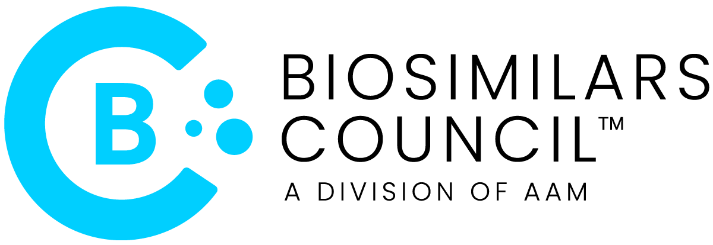
U.S. Biosimilars Market – Buy and Bill
As of September 2025
Source: FDA Purple Book.

Slide 31
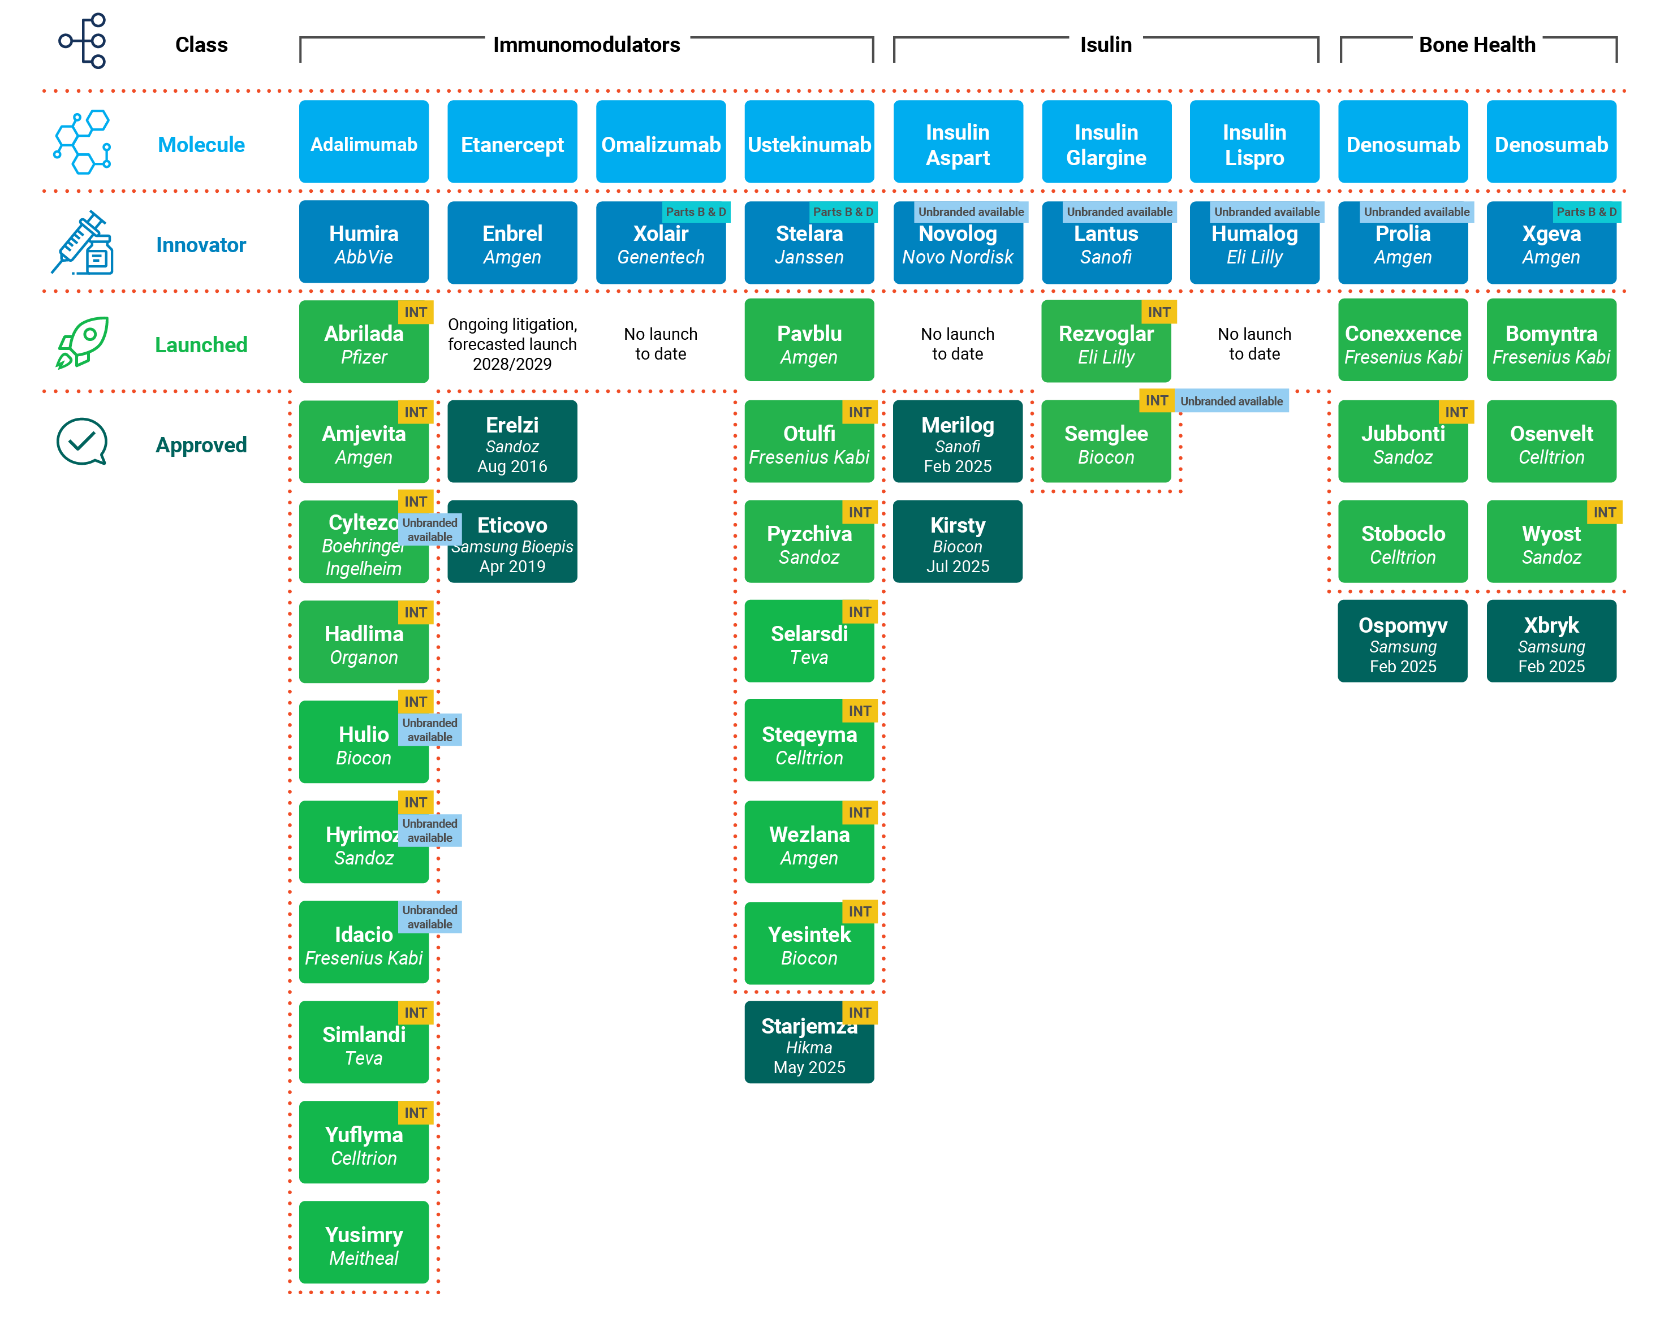
U.S. Biosimilars Market – Prescription Benefit
As of September 2025
Source: FDA Purple Book.

Slide 32
Biosimilars Have Generated $56.2B in Savings Since 2015, With Nearly Half From Infliximab and Pegfilgrastim
Biosimilars Generated $20.2B in Savings in 2024
Source: IQVIA National Prescription Audit, December 2024; IQVIA Institute, June 2025.

Slide 33
Biosimilars Are Now a Core Element of Patient Care
3.3
460
BILLION
Total Days of Therapy for Patients on Biosimilars
MILLION
Additional Patient Days Due to the Availability of Biosimilars
Source: IQVIA analysis of defined daily dose information and product volume.

Slide 34
High-Value Biologics Are More Likely to Have Biosimilars in Development as There Is Greater Potential for Revenue
Share of Biologics With Biosimilars in Development by Pre-Expiry Sales, Expiries 2025–2034
n=118
Source: IQVIA Institute for Human Data Science. February 2025. Assessing the Biosimilar Void in the U.S.: Achieving Sustainable Levels of Biosimilar Competition. Available from iqviainstitute.org.

Slide 35
Although Improving, Biosimilar Market Share Remains Low
Biosimilar Market Share Is on Average 40%, Up From 20% Last Year
Source: IQVIA National Sales Perspective, December 2024; IQVIA Institute, June 2025.

Slide 36
Biosimilars Launch at a Discount and Continue to Decrease Their Prices

Slide 37
Biosimilar Competition Can Lead to a “Race to the Bottom”
In the First 3 Years After Biosimilar Entry, an Average Originator Brand Suffers a ~23% Drop in ASP and a Nearly Two-Fold Increase in List-to-Net Gap
Molecule-average ASP is declining faster than originator ASP due to lower prices of biosimilars
Molecule ASP
Originator ASP
Originator WAC to ASP Gap
On average,
-39%
in first 3 years of
Biosimilar Market Presence
On average,
-23%
in first 3 years of
Biosimilar Market Presence
On average,
1.8x
Increase in off-WAC discounting in first 3 years of Biosimilar Market Presence
Source: US Market Access Strategy Consulting analysis, CMS ASP Data, NSP Sales, Redbook WAC Data

Slide 38
Biosimilar Competition Can Lead to a “Race to the Bottom”
Second-to-Market Biosimilar Launched Within 3 Years of the First One Has Potential to Nearly Double the ASP Pressure
Further competition (3rd and later biosimilars) does increase ASP pressure, but marginal impact of further launches is lower than that of the first and second biosimilars
+29%
+58%
+37%
+20%
+75%
+19%
1 Biosim | Filgrastim, Epoetin Alfa
2 Biosims | Infliximab, Bevacizumab, Ranibizumab
3+ Biosims | Pegfilgrastim*, Trastuzumab, Rituximab*
# of Biosimilars
Time Since Launch of First Biosimilar
Year 1
Year 2
Year 3
Source: US Market Access Strategy Consulting analysis, CMS ASP Data, NSP Sales, Redbook WAC Data

Slide 39
While the Launch of Co-branded Treatments Grew Biosimilar Use in 2024–Q2, PBMs Continue to Play a Large Role in Patient Access to Biosimilars
Most Biosimilar Growth Can Be Attributed to Co-Branded Hyrimoz, and Volume Still Trails AbbVie’s Imm. Portfolio
Co-Branded Hyrimoz is Driving Increased Biosimilar Utilization
Large PBMs Continue To Favor Humira or
Co-branded Options
Product Hopping Outpaces Biosimilars
2,822K
3,155K
3,667K
1,478K
9%
9%
73%
72%
34%
33%
32%
28%
4%
4%
Source: IQVIA LAAD 3.0, US Market Access Strategy Consulting analysis.

Slide 40
Biologic Expiries 2025–2034 and Biosimilar Pipeline by Therapy Area
The Image Below Shows That Biosimilar Pipeline Development Is Limited to a Few Specific Therapy Areas — With the Rest Stuck in the Void
Source: IQVIA Institute for Human Data Science. February 2025. Assessing the Biosimilar Void in in the U.S.: Achieving Sustainable Levels of Biosimilar Competition. Available from iqviainstitute.org.

